Slide 1
Stemming in Evergreen Search

Slide 2
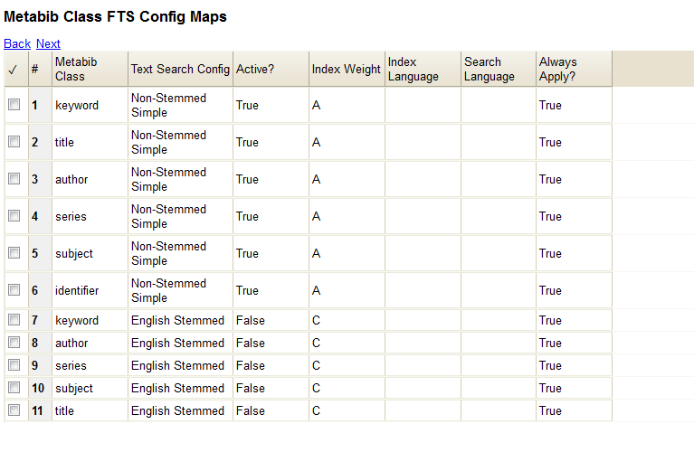

Slide 3
Example Where Stemming is a Known Problem
Keyword search:
pacifism world war II

Slide 4
Results
Stemming turned on
Stemming turned off
Friends and enemies / LouAnn Gaeddert.
Pacifism in the twentieth century / by Peter Brock and Nigel Young.
We who dared to say no to war : American antiwar writing from 1812 to now / [edited by] Murray Polner, Thomas E. Woods, Jr.
Wartime dissent in America : a history and anthology / Robert Mann.
Americans' views about war / James D. Torr, book editor.
The Power of the people : active nonviolence in the United States / edited and produced by Robert Cooney and Helen Michalowski.
The Power of the people : active nonviolence in the United States / edited by Robert
World War II. Pacific / Barbara Williams.
World War II, Pacific Theater [electronic resource]
World War II, Pacific Theater, 1941-1945 [electronic resource]
World War II in the Pacific / R. Conrad Stein.
World War II, Pacific Theater, 1941-1945
World War II memories South Pacific / by Lena R. Gelott Styles. Styles, Lena R. Gelott
World War II : the war in the Pacific / by Don Nardo.

Slide 5
Example Where Stemming Helps
Author search:
Terry Dulong

Slide 6
Results
Stemming turned on
Stemming turned off
Secrets on Cedar Key / Terri DuLong.
Postcards from Cedar Key / Terri DuLong.
Postcards from Cedar Key / Terri Dulong.
Sunrise on Cedar Key / Terri DuLong.
Casting about / Terri DuLong.
Holiday magic / Fern Michaels ... [et al.].

Slide 7
Generic searches mostly retrieved relevant results in both systems.
User testing would be beneficial.

