Slide 1
Prepare to Share Resource Sharing in a Library Consortium
Evergreen International Conference
Hood River, OR
May 2015

Slide 2
Prepare to Share Agenda
Introduction
NC Cardinal Overview
NC Cardinal Holds Strategy
Workflow
Tracking
Reports
Q&A / Experience Share

Slide 3
NC Cardinal Overview
Date | Timeline
July 2010 | NC Cardinal Consortium formed to support public libraries
Feb 2013 | Resource Sharing Begins with 13 Library Systems
May 2015 | NC Cardinal is now in 31 counties (23 library systems including regionals & municipalities)
Comprised of 1/3 of all public library systems in NC
and growing…

Slide 4
NC Cardinal Overview
State Library of North Carolina (SLNC) Program:
Administered by Library Development Staff
Advisory/Steering Committees
Key among consortium advantages is resource sharing
Support:
Documented Best Practices
Shared shipping account
Impact on patrons:
Patron access to previously unavailable materials
Member libraries experienced a 70% decrease in hold request wait times upon joining the consortium

Slide 5
NC Cardinal Statistics
Active Patrons | 1 million+
Library Items | 5.1 million
Bibliographic Records | 1.5 million
Monthly Circulations | Half million
Average Monthly Transits | Quarter million

Slide 6
NC Cardinal Transit Numbers
Avg = 250,000

Slide 7
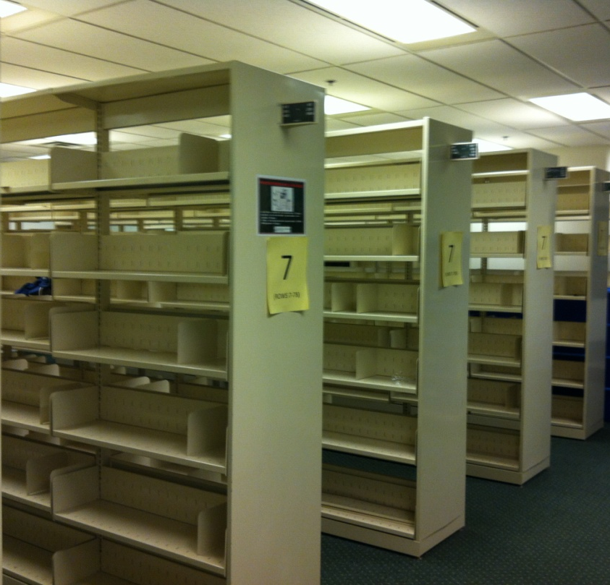
NC Cardinal Holds Strategies
Goals of Holds Strategies:
Easy for patrons & staff
Serve local patrons first
Optimize speed & efficiency
Age protection
Format protection
No Empty Shelves!

Slide 8
NC Cardinal Holds Strategies
Evergreen Configuration
Hold Levels
Meta-record, Title, Parts
Volume, Copy – staff only
Protection by Item Attributes
Age-based holds
Format (circ modifier)

Slide 9
NC Cardinal Holds Strategies
Opportunistic Capture
Configured with 7 day soft stalling interval
Fill hold internally before targeting another system
Opportunistic Location Capture
Other Possibilities
First In, First Out (FIFO)
Holds Go Home

Slide 10
Workflow Forsyth Overview
Forsyth County joined NC Cardinal Feb 2014
Library Structure:
9 Branches + 3 Outreach Divisions
Size:
350,000 County Population (2010 Census)
165,000 Registered Patrons
750,000 Library Items (one of the largest collections in NC Cardinal)
6,700 Monthly Average of inter-library transits in 2014
9,500 Monthly Average of inter-library transits in 2015

Slide 11
Workflow – Forsyth Numbers
2015 Avg
9,500
2014 Avg
6,700
April 2015 largest month to date: 12,814
 | Borrowed | Loaned
2014 | 67% | 33%
2015 | 79% | 21%

Slide 12
Workflow Methodology
Across NC Cardinal existing staff take on additional responsibilities (few dedicated staffers)
Forsyth County began with 2 people
Initially, completely underestimated effort
Responsibility remains with Technical Services Department
Current department of 7 regular staff + Courier
Keys to Success
Be Prepared
Be Consistent
Be Adaptable

Slide 13
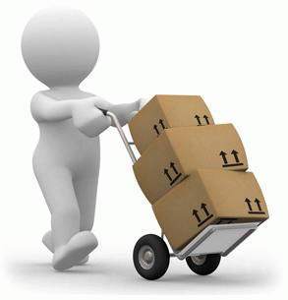
Workflow Forsyth Approach
Receiving
Daily – 1 person
300 items per day average
Logging
Sorting by Branch
Shipping
Frequency
At least once per week
Some ship daily
Forsyth ships 3 x week
Cost-Effectiveness
Box Size & Weight
Logging/Packing
4,700 items per month average
Teams of 2
Digital Postal Scale

Slide 14
Tracking Importance
Where’s my book?
Use Evergreen to track item status changes from “Available” to “In Transit” to “On Holds Shelf”
Need supplemental data for physical movement of an item in between status changes (when item was actually boxed and shipped)
Quality control and issue resolution
Why it matters
Box breaks in transit – UPS repackages
UPS maintains shipping history of box – not items within
In-depth investigation of patron issues (track when item shipped originally and when/if it was returned)

Slide 15
Tracking Logs
Maintain Incoming & Outgoing Logs
(Combine with UPS History)
Example: Incoming Log

Slide 16
Tracking Logs
Maintain Incoming & Outgoing Logs
(Combine with UPS History)
Example: Outgoing Log

Slide 17
Tracking Problem Items
Types
Missing discs
Damaged cases
Bad condition
Lost items
Communication
Quick messages
Item Note form

Slide 18
Reports Transit Activity
Evergreen
Hold Requests Filled by Consortium Members
Items Loaned by Consortium Members
Intra-Library In-Transit List
Inter-Library In-Transit List
Hopeless Holds
Statistical
Holds Transit Grid Weekly
Averages & Trends from Daily Logs
Administrative Updates

Slide 19
Reports Holds Transit Grid

Slide 20
Reports Administrative

Slide 21
Questions/Comments

Slide 22
Wrap-Up
Closing Thoughts…
Contact Us:
Jennifer Dale daleji@forsyth.cc
336-703-3049
Jonathan Furr furrjt@forsyth.cc
336-703-3045

