Slide 1

Melissa Ceraso & Brent Mills

Slide 2
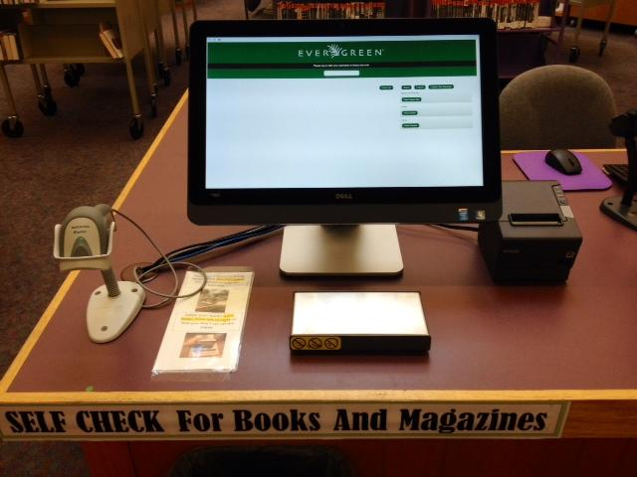
Why Self-Check?
Curiosity
Excitement
Freedom
Quick and simple
Becoming the norm
Notes:
Nowadays, people are getting more acclimated to the use of self-check machines. Showing up in more common places: airports, grocery stores, and now, more and more libraries.

Slide 3

Great! Now why Evergreen Self-Check?
Say it all together: OPEN SOURCE!
Contains all the main reasons why we heart Evergreen
  Easy to implement
  Customizable
  Ability to develop
Notes:
We can all agree that self-check with Evergreen is far better than utilizing a self-check from a vendor. First and foremost, open source offers endless opportunities in terms of implementation, customization and development. At Bibliomation, we have found that many libraries often believe that there is a yearly maintenance fee for the self-check, as they are so used to dealing with vendors.

Slide 4
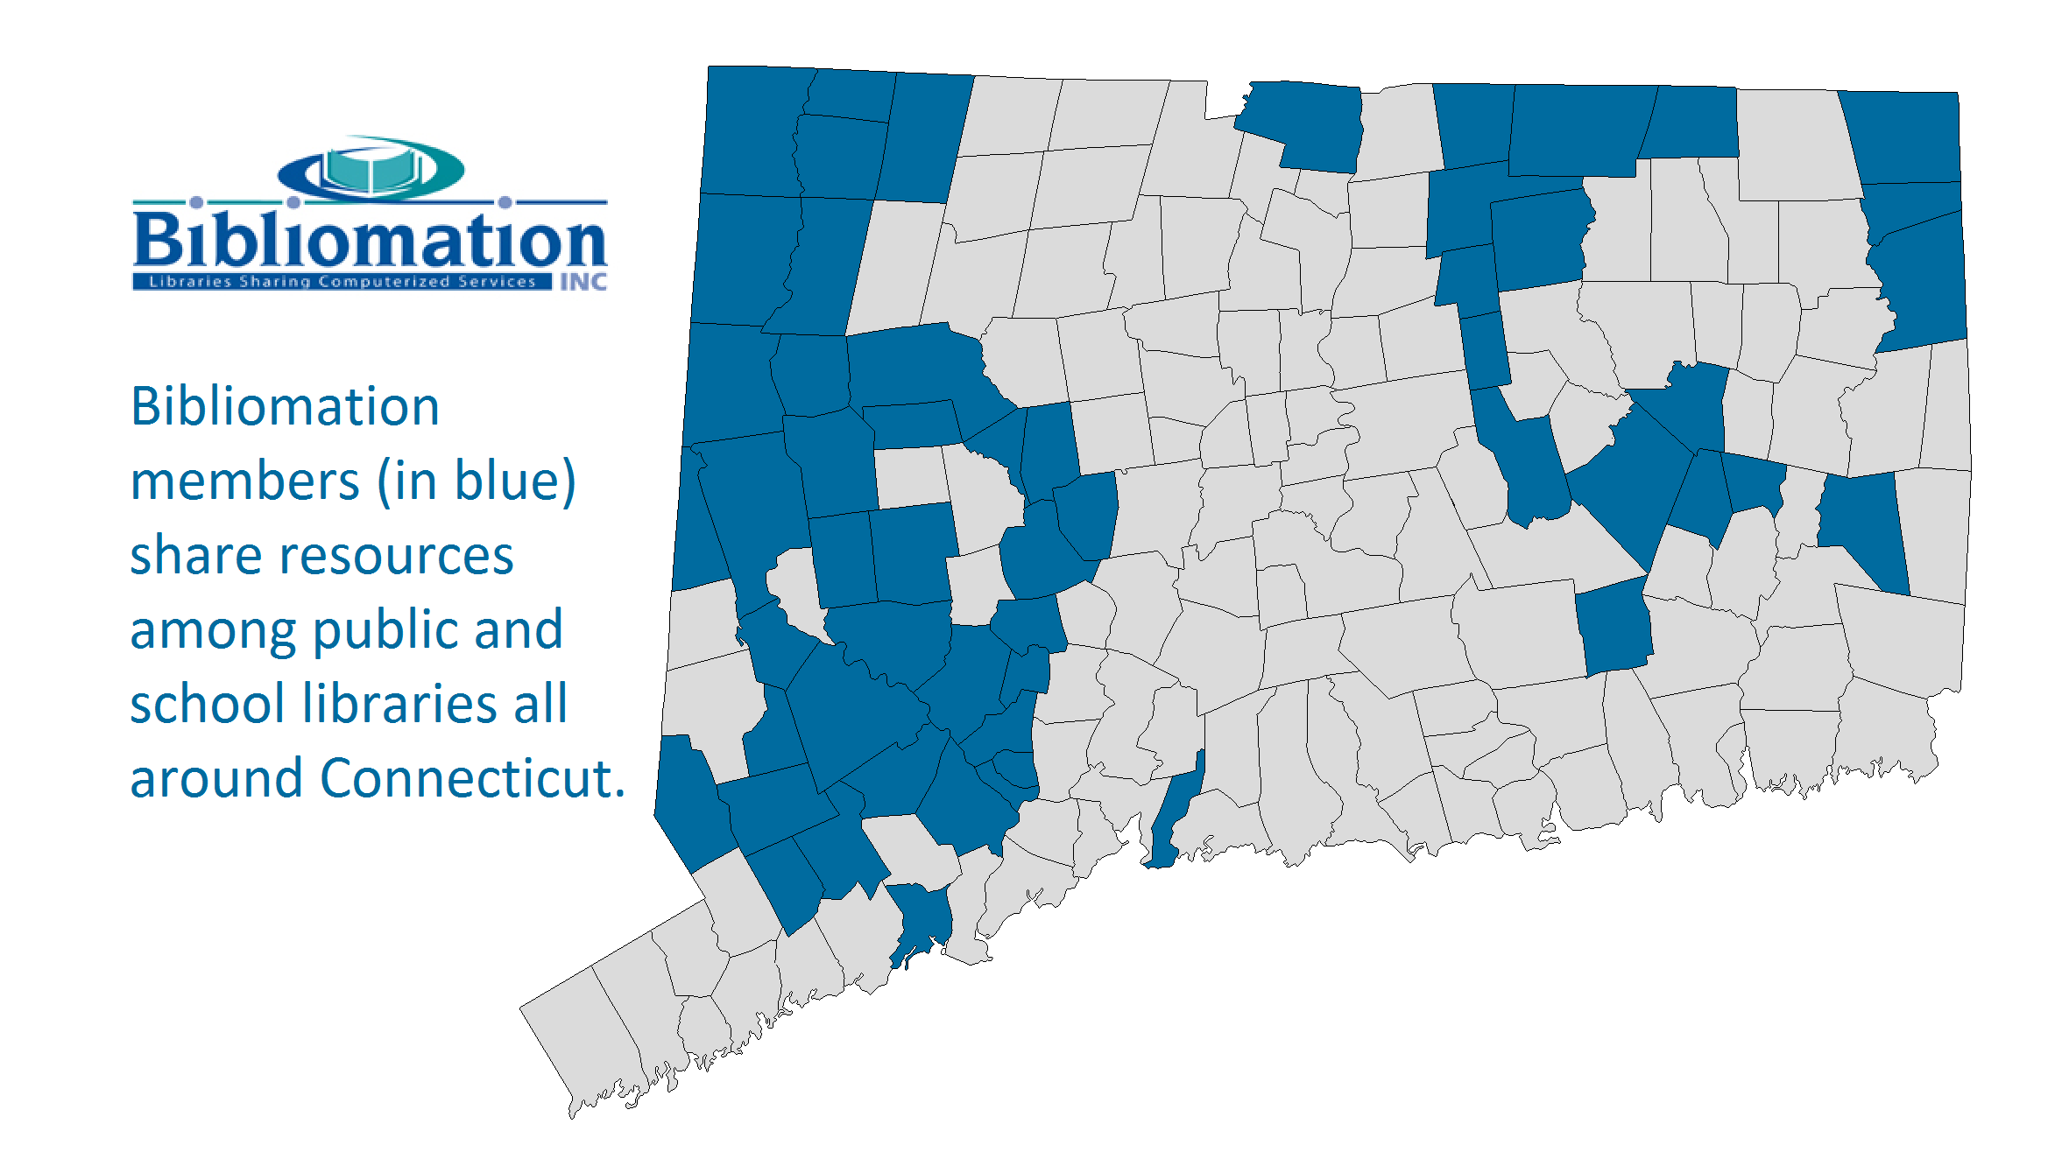
Brief Bibliomation Background
Largest of Connecticut’s library consortiums
59 public libraries
16 K-12 school libraries
Migrated to Evergreen in 2011

Slide 5
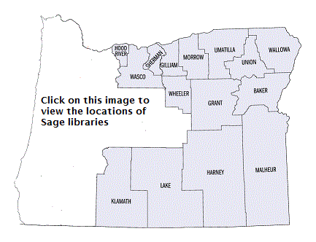
Brief Sage Background
Consortium of 76 member libraries in fifteen counties of eastern and central Oregon
Migrated to Evergreen in December, 2010
Notes:
Large geographic coverage with small service populations. Started out on 1.6 then quickly moved over to 2.0. Equinox migrated us from the previous . Around 60 libraries migrated on in the first wave.

Slide 6

Bibliomation’s Self-Check Pilot Project
Initiated in the Spring of 2014
Two interested libraries on
opposite sides of the state
Need for solid documentation
and implementation

Slide 7
Setting up a self-check station
https://[hostname]/eg/circ/selfcheck/main
Workstations?
  Enable: Library Settings > Self Check: Workstation Required
Login with a staff account that has circulation privileges
Create a self-check user profile
Notes:
If you are going to be running reports, it’s advisable to set “Self Check: Workstation Required” so that you have a means of tracking circulations by checkout station.

Slide 8
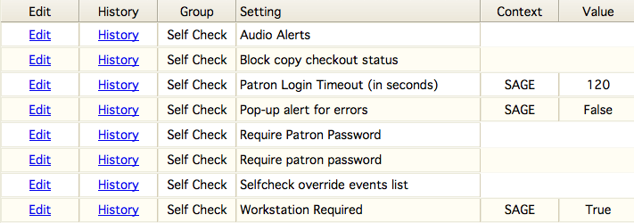
Library Settings
Override events list (LP 1371752)
Notes:
We had an issue at Hood River where patrons would inadvertently double scan their items, consuming a renewal.

Slide 9
Customize!
Logo?
  banner.tt2
Custom checkout sounds?
  audio_config.tt2
    make sure “Self Check: Audio Alerts” Library Setting is enabled
Receipts?
  Admin > Local Administration > Notifications / Action Triggers
    Self-Checkout Receipt + Fines/Holds/Items Out Receipts
Notes:
If you’re using checkout sounds you’ll also have to copy over the default sound files as recommended in http://docs.evergreen-ils.org/2.7/_self_checkout.html. There are hooks for login success/failure and checkout success/failure.

Slide 10
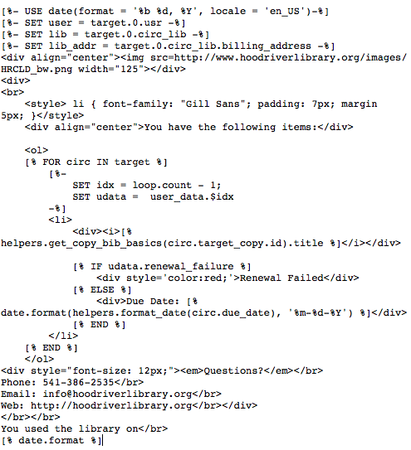

Custom Checkout Receipts
Notes:
The two libraries that are using Evergreen’s selfcheck module in Sage both use customized receipts that display their library’s logo.

Slide 11
Ready, Set, GO!
The right hardware recipe
  “All-in-One” Self-Check Order Form
    Barcode Scanner - read barcodes off of smartphones
    Thermal Receipt Printer
    Touchscreen Monitor
OpenKiosk - locks down web browser
  Mozilla Firefox
  Administrative side
  Allows for timeout within a certain period of inactivity (allegedly)

Slide 12
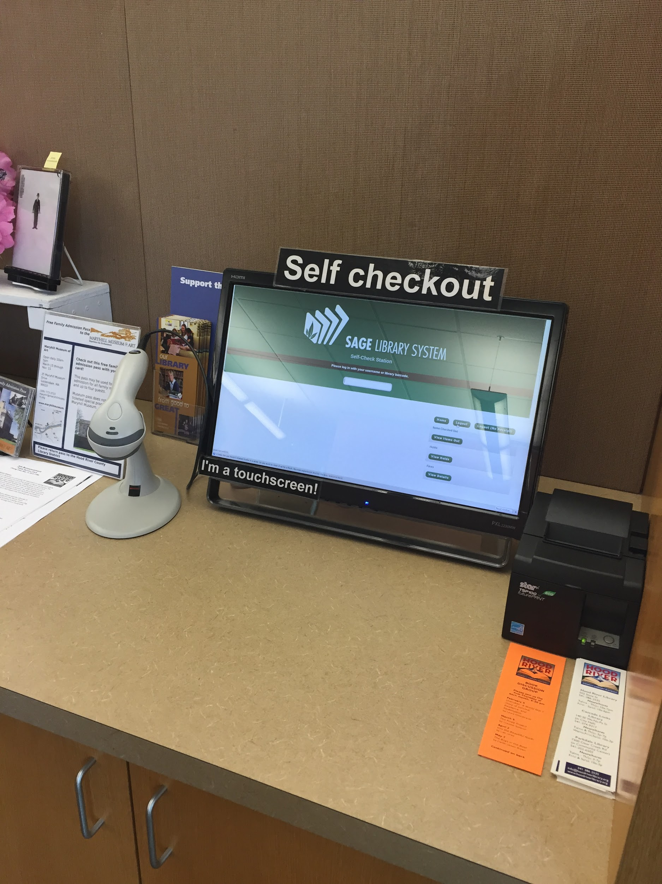
Example Self Check Setup
Linux Mint/Cinnamon
8gb RAM / 250gb HD
Planar PXL 2230 MW Touchscreen
Star TSP 100 Receipt Printer
Honeywell Scanner
Firefox Addons
BlockSite (whitelist catalog only)
Public Fox (lock settings)
Reset Kiosk (cycles every minute)
Older Computers? Chromebox?
Notes:
This is an example of a self check station in Hood River. There is another station with a similar setup in the Kids area. These are provisioned quite heartily. One recommendation for an example setup is to hide the keyboard and mouse if you’re using a touchscreen, or simply have the mouse (corded) if you do not (and aren’t using passwords).

Slide 13
We NEED reports!
Based on the self-check user profile
Workstation-by-workstation basis
Easy to generate
Notes:
After setting up a self check with our first library, they immediately came back to us asking whether it was possible to generate reports to prove to their library board that purchasing the equipment was worth it. Our reports guru spoke with the library and asked what their specific needs were. Based on these needs, we created a report.

Slide 14
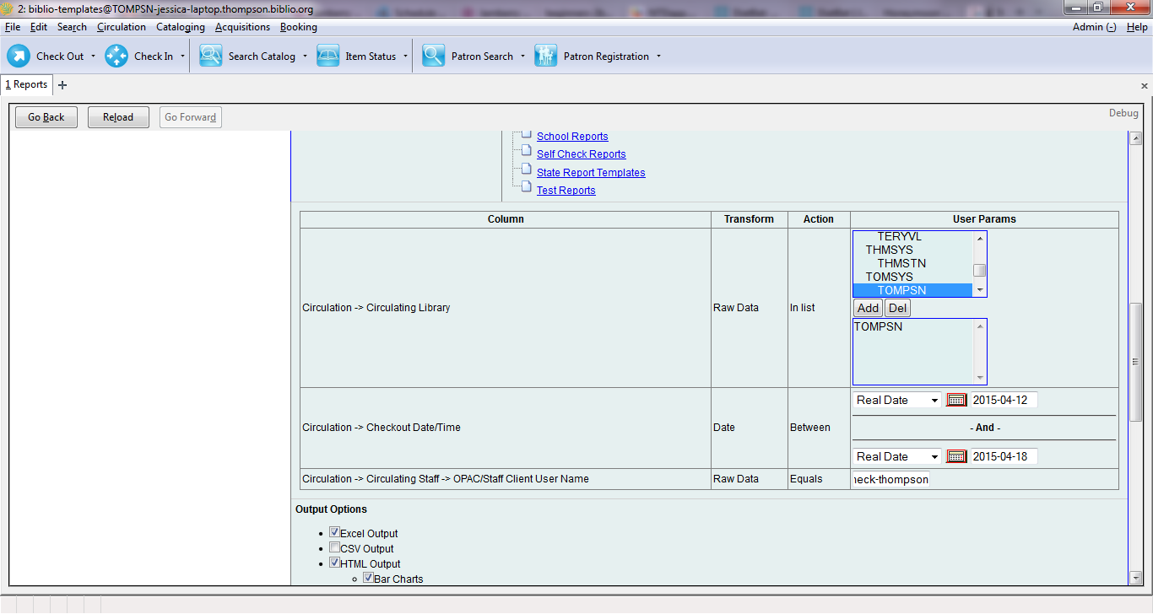
Notes:
The report that is about to be run is filtered by circulating library, checkout date, and workstation.

Slide 15
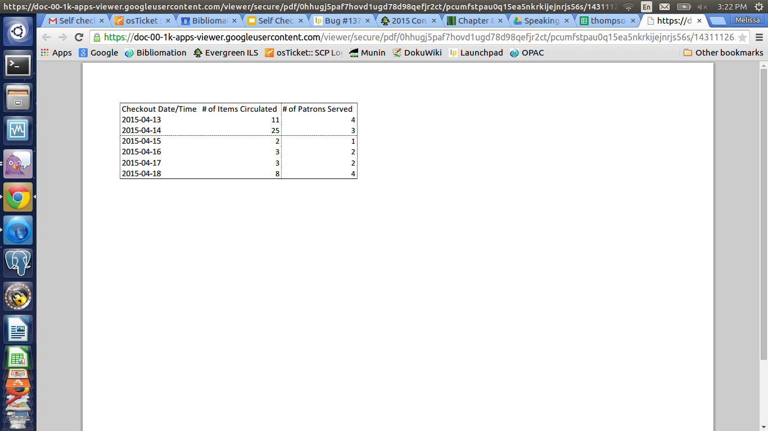
Report Output Example

Slide 16
Sage Hiccups
Barcode Regex
Self Checks with Patron Passwords
Small libraries not finding it necessary
Notes:
Largest Sage service district serves 26,000 people. One of the smaller districts is around high 700s. Patron interaction is an important part of the librarian’s job.

Slide 17
Bibliomation Hiccups
Using older equipment from vendor self-check machines
Trouble with OpenKiosk (time-out settings and printer settings)
Inability to limit circ items
Specific special requests with receipt printer output
Notes:
One of our libraries presented us with antique (at best) equipment: The machine was from 2002 and had 256 MB of RAM and Windows XP. They also had an older touch screen machine from a vendor that required us to tinker around with settings. Initially, it rendered an inverted touch response. This is what precipitated the need for an “All-in-One” Form, which serves as merely a recommendation.
We also found OpenKiosk to be slightly buggy with the timeout settings. Printer settings were a little strange, as well. We were getting receipts that were a couple feet long.
Another issue that is that the library would like to limit the type of circ items that they are allowed to have their patrons check out via the self-check. Mainly CDs and DVDs. The workaround for this is that staff have to watch what their patrons check out -- or they leave signage by the self-check machine.

Slide 18
Default File Locations
js:
/openils/var/web/js/ui/default/circ/selfcheck
css:
/openils/var/web/css/skin/default
tt2 files:
/openils/var/templates/circ/selfcheck
-- don’t be confused by the old XML selfcheck files! --

Slide 19
Location and Education
Area with heavy foot traffic
Close to the circ desk
Staff willing to demo
Plenty of signage/easy instructions

Slide 20
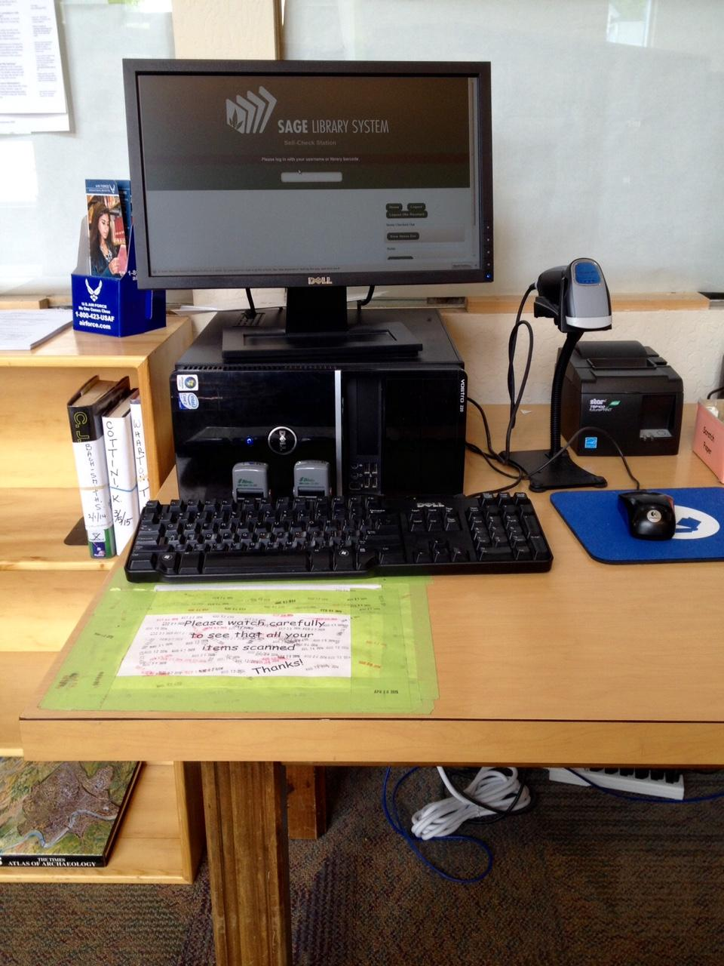
Thank you!
Questions?
Lakeview, OR - Main Library

