Slide 1
Welcome to
Evergreen International Conference 2016
Raleigh, North Carolina

Slide 2
Come on in…
Ruth Frasur
Director, Hagerstown-Jefferson Township Library
Evergreen Indiana Executive Committee Chairperson
Proud community member since 2008
Kathy Lussier
Project Coordinator, Massachusetts Library Network Cooperative (MassLNC)
Proud community member since 2010
Shae Tetterton
Director of Sales, Equinox Software Inc.
Proud community member since 2008

Slide 3
Icebreaker!
Don’t Panic….

Slide 4
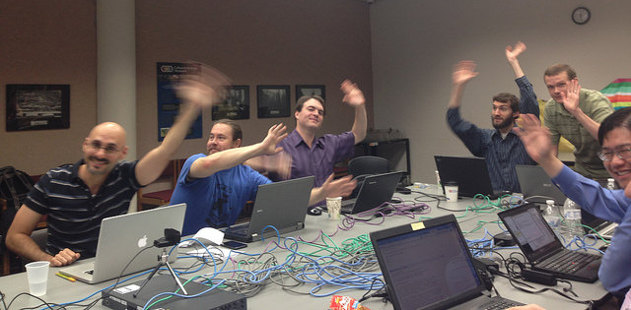
What is the Evergreen Community?
The Evergreen community is made of institutions and people who use and/or support the Evergreen ILS and choose to participate with others in the community. We are a diverse group made up of over 1,800 libraries worldwide.

Slide 5
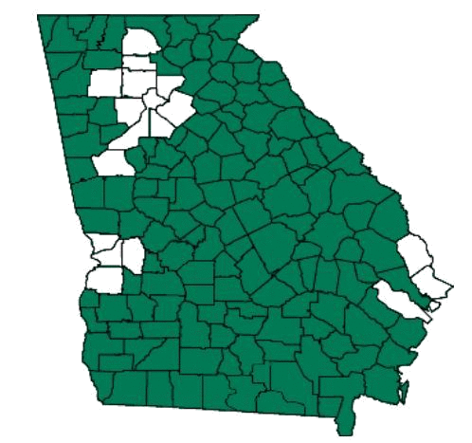
In the beginning…

Slide 6
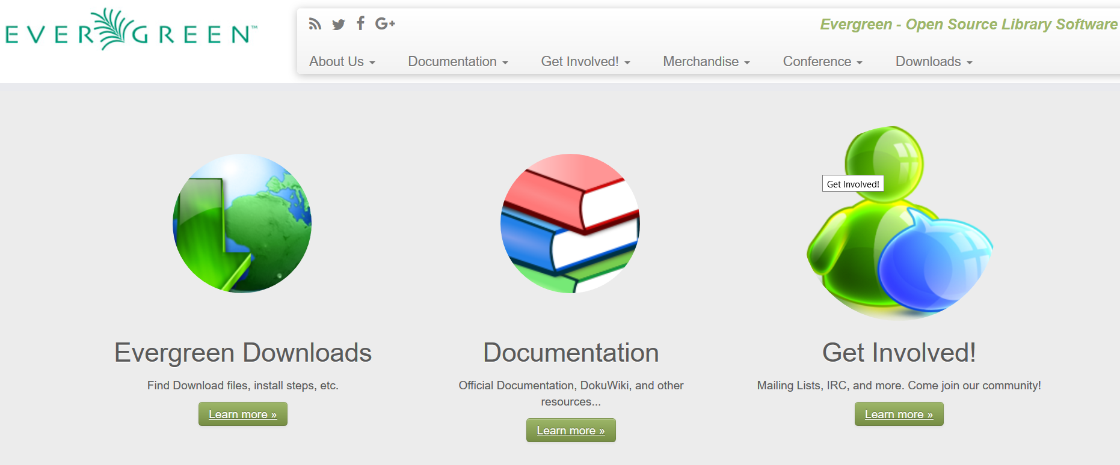
Evergreen – Open Source ILS
Released under the GNU Public License (GPL)
Anyone can use it and modify it
Anyone can publish extensions

Slide 8
Common Questions
Who is my vendor?
Do I need a developer on staff?
Is it sustainable?
Can just anyone commit changes to the code?
Will it save me money?
Does Evergreen have the features my library needs?
You choose! No vendor lock in!
Definitely not.
Evergreen has a very mature community and multiple vendors support it. It will live on!
Yes but there are strict rules enforced for who can commit changes to the master EG code base.
Probably not initially but there are reports of moderate to significant savings long term
Evergreen is a mature ILS with all the features of a modern ILS. Here’s how you can find out…

Slide 9
Try it out!
Easy as 1, 2, 3
Downloads: https://evergreen-ils.org/egdownloads/
Demos: http://wiki.evergreen-ils.org/doku.php?id=community_servers#community_demo_servers
Documentation: http://docs.evergreen-ils.org/

Slide 10
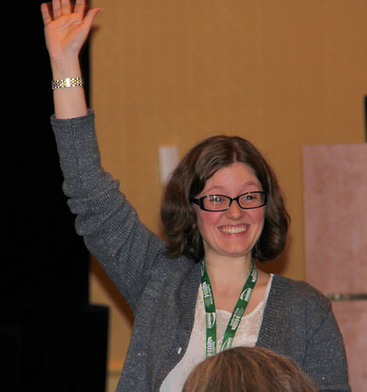
Get Involved! (No Programming Skills Needed)
Join a listserv and introduce yourself
Stop by IRC #Evergreen
Connect with Evergreen libraries in your area
Attend an Evergreen conference (look, you’re already involved!)
https://evergreen-ils.org/involvement/

Slide 11
Community Groups
Evergreen Oversight Board
Documentation Interest Group
Evergreen Web Team
Evergreen Outreach Committee
Evergreen Reports Interest Group
Evergreen Cataloging Working Group
Acquisitions Interest Group
Academic Interest Group
https://evergreen-ils.org/communicate/committees/

Slide 12
Questions?
Ruth: director@hagerstownlibrary.org
Kathy: klussier@masslnc.org
Shae: shae@esilibrary.com

