Slide 1
The Secret Life of Electronic Resources:
A Tale of Transcendence
April Durrence and Catherine Prince

Slide 2
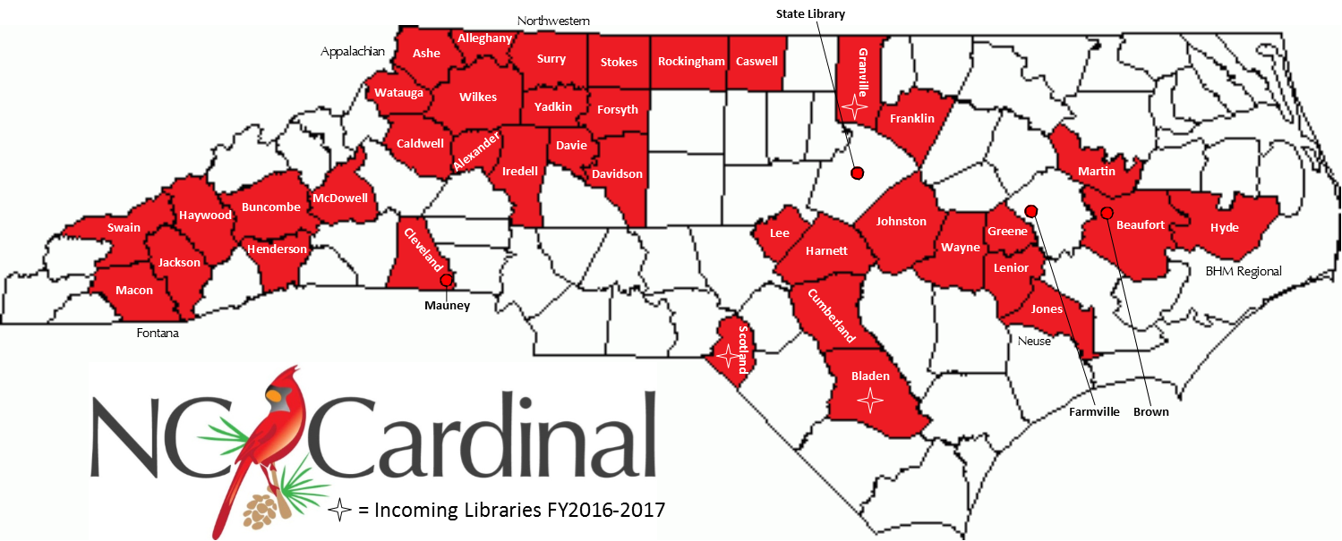
Overview
Notes:
The NC Cardinal consortium started in 2011 with 3 library systems and a municipal library. With 3-5 library systems joined each year, we have grown to 30 public library systems (out of 81 statewide) and we recently migrated the North Carolina Government and Heritage Library and affiliated state agency libraries. Resource sharing of materials is a valuable benefit to library patrons across North Carolina. Those libraries share 1.8 million bibliographic records and resource share the majority of their 6.3 million items, so finding the right item can sometimes be a challenge.

Slide 3
Who Needs Books? by nate bolt (CC BY-NC 2.0)
Notes:
This can be especially true for electronic resources. We have almost 113,000 items (1.8% of our collection) that are either an electronic resource or have a digital component (form "o" or "s"; for the catalogers in the audience).

Slide 4
Consortial e-resources
Notes:
We began adding electronic resources to our catalog in 2012 from a number of sources. All North Carolinians have free access to a powerful array of digital content and services provided by public, community college, and academic libraries through a cooperative library service called NC LIVE. This includes e-books, e-audio, academic journals, popular magazines, and videos. Additionally in NC, our state legislature set aside funds to establish a statewide e-resource consortium specifically for children. These resources are curated for ages pre-K through 4th and available to all children across the state. There are currently over 5000 titles available with over 300 titles available for simultaneous access. Our State Library also has over 30,000 born digital and digitized state documents available with content ranging from session laws to transportation maps.

Slide 5
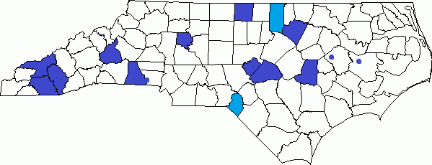
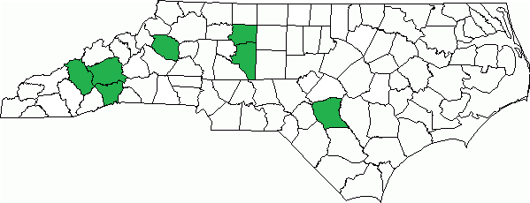
Purchasing Groups within the Consortium
12 existing NC Cardinal members with 2 new members in FY 16-17
7 existing NC Cardinal members
Notes:
While some electronic resources in the NC Cardinal catalog are available to all patrons, others may only be available to patrons of one system or a limited group of systems. NC Cardinal has several member systems who are part of purchasing groups within the consortium, NC Digital and e-iNC. The composition of these purchasing groups can change on a yearly basis as more libraries migrate in, which adds a frustrating component to update existing resources. e-iNC has two new systems that are joining this year and their org units are not applied to previously loaded resources, so their patrons are missing out.

Slide 6
System owned e-resources
EVERYONE
(Envision Oprah handing out books here)
Notes:
Resources are purchased for their individual systems, as well, so there can be overlap in the bibliographic record between these different units. If not cataloged to scope appropriately, those e-resource items with limited availability may show in search results for patrons who are not eligible to access them, even if the search is scoped to the patron's home library system. Patrons and library staff find it frustrating to see these items in search result!

Slide 7
Bibliographic Record Source
Can be used to identify where a record comes from and determine how an item should show in search results.
Transcendent: shows in all search results, regardless of scope
Non-transcendent: only shows in particular search results based on
Catalog search scope
Patron preference settings
Item ownership
Notes:
One option is to utilize bibliographic source. The Bibliographic Record Source in Evergreen can identify where a record comes from and it can also help determine whether an item should show in all search results regardless of scope (transcendent) or only in particular search results based on catalog search scope, patron preference settings, and ownership (non-transcendent).

Slide 8
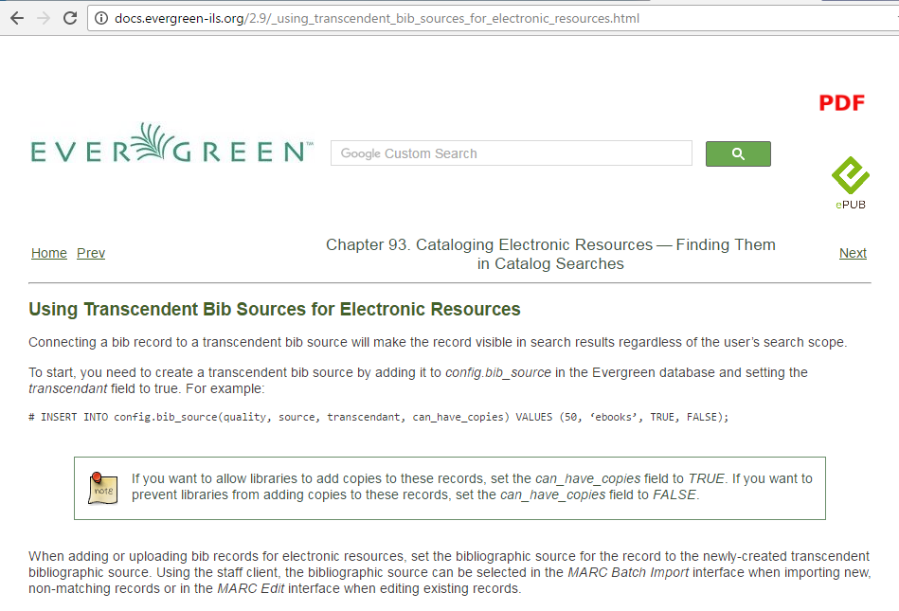
Notes:
The terminology can be somewhat misleading, since naming the source of the record (where it actually comes from) is not important to the transcendence functionality. Whether or not a source is transcendent is determined by the code in the database.

Slide 9
Settings in NC Cardinal
Non-transcendent bib sources:
oclc (stock)
System Local (stock)
Transcendent bib sources:
Project Gutenberg (stock)
Learning Express (deleted)
Miscellaneous e-resources (Changed to Consortium e-resources)
NC LIVE
Global flag - When enabled, Located URIs will provide visibility behavior identical to copies - set to false
Notes:
This is an overview of our original setup. We did not add a large number of sources and found that "Miscellaneous e-resources" was misleading, so changed it to "Consortium e-resources" to clarify that it should be applied only to electronic resources that everyone has access to.

Slide 10
“Record Source” in Acq MARC upload
No selection required
Notes:
When importing acquisitions records, the Load MARC order records screen in the Acquisitions module does not require a selection from the Record Source list.

Slide 11
“Record Source” in MARC Batch Import
selection required
Notes:
A Record Source is required on the MARC batch import/export screen.

Slide 12
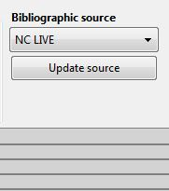
“Bibliographic Source” in MARC record
Click to save
Notes:
In an existing MARC record, "Bibliographic Source" is the term used for the same list of non-transcendent and transcendent sources. Because the Bibliographic Record Source can be "sticky" in batch import screens, it is easy to mistakenly leave it as a transcendent source. We had to do some cleanup to fix items that were imported with a transcendent source by mistake. This record is for an NC LIVE e-book and should be transcendent. If a bib source is incorrect for the type of record, it can be corrected in MARC Edit by selecting and clicking on the update source button.

Slide 13
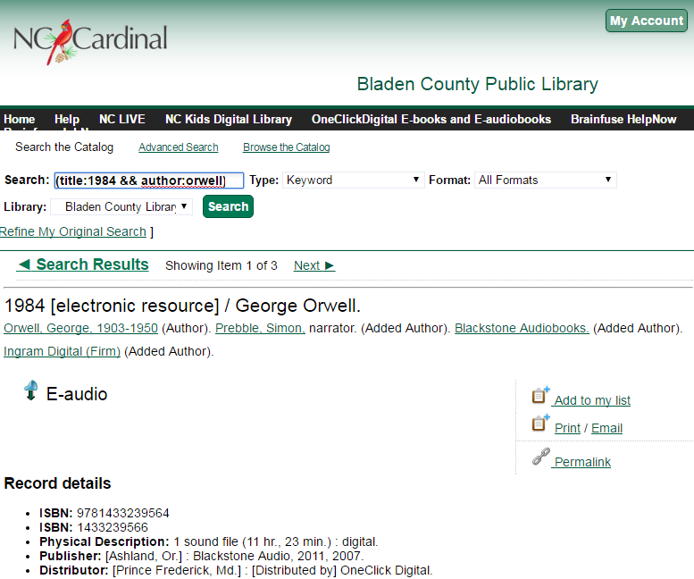
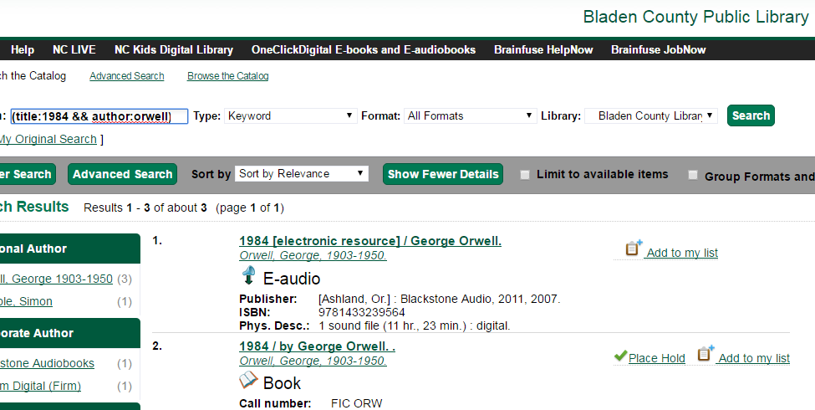
Transcendent
Notes:
A Transcendent Bibliographic Record Source was only intended to be used when all libraries in the consortium have the same access to an electronic resource, such as that NC LIVE e-book, never for physical holdings like a print book or AV material.

Slide 14
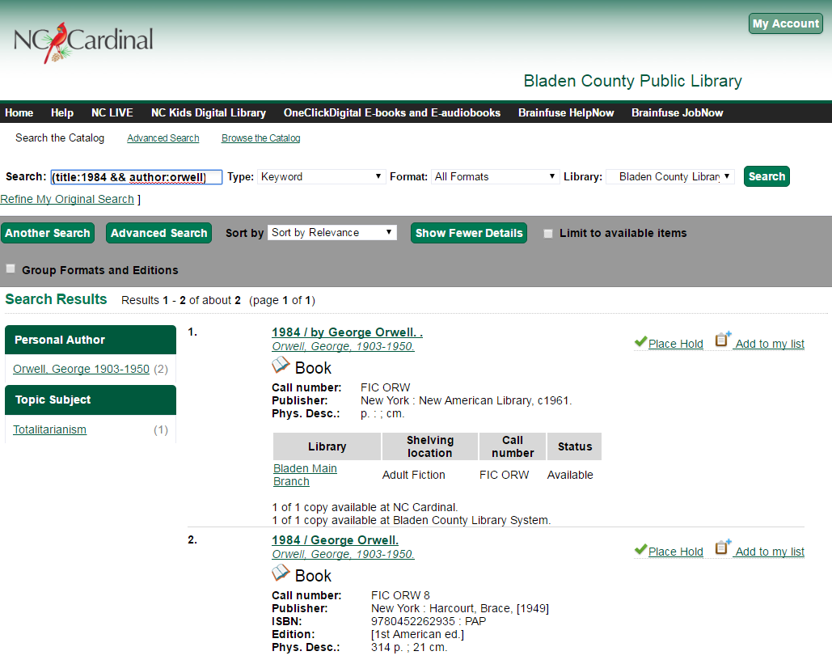
Non-transcendent
Notes:
There were some interesting use cases for using bib source to specify vendors or a migrating library's records discussed in Rogan's The Usual Suspects presentation at the pre-conference on Wednesday, and we may explore using some of those ideas in the near future. At the time, we focused on making the electronic resources that were available to all libraries transcendent and the ones for individual libraries or purchasing groups non-transcendent.

Slide 15
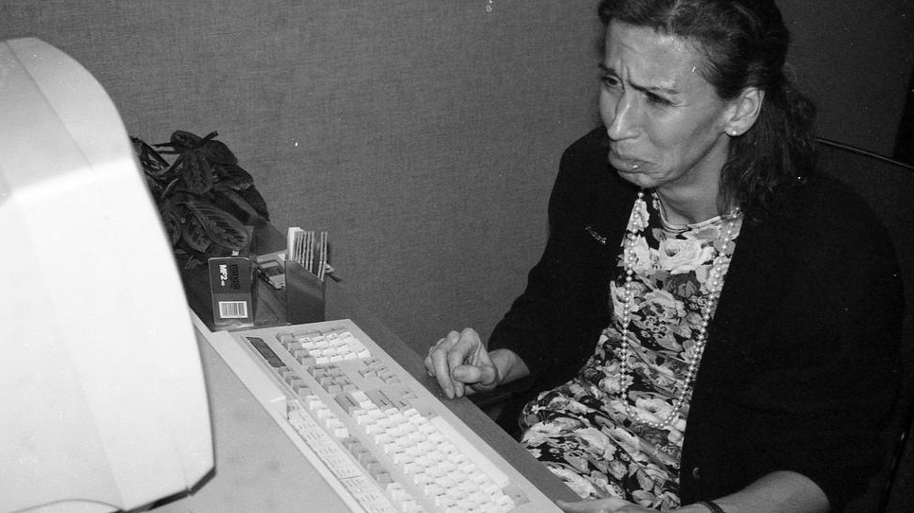
1989-negatives-sheet43a-05 by Paul-W (CC BY-NC-SA 2.0)
Notes:
What did transcendence do for us? As it turns out, not as much as we had hoped. Staff were still having to scroll through electronic resources in the staff client. How about you all? Does anyone have anything to share or ask about using transcendent bib sources?

Slide 16
Located URIs
A Located URI (Uniform Resource Identifier) is useful when only some library systems in the consortium have access to a particular electronic resource.
The link to the external database where patrons access the electronic resource is placed in $u in the 856 field of the MARC.
By adding a $9 with the short (policy) name for each system with access, a cataloger enables Evergreen to limit the search results to the specified organizational units who own the “item”.
Only these owning systems will see the electronic resource in their consortium or system scoped search results.
Notes:
We found Located URIs to be a much more useful way to scope searches for both patrons and staff. A Located URI or Uniform Resource Identifier is necessary when only some library systems in the consortium have access to a particular electronic resource. The link to the external database where patrons access the electronic resource is placed in $u in the 856 field of the MARC.

Slide 17
Adding Located URIs
Required:
856 field
indicators 4 and 0/1
$u: URL (web address)
$9: org unit short policy code (case sensitive)
Optional tags:
$x: non-public note - consortia source (i.e. nclive)
$y: link text (to display instead of raw web address in $u)
$z: public note
$3: materials specified (for other types of links – table of contents, sample text, etc.)
Notes:
The 856 field is required, as is the $u. By adding a $9 with the short name for each system with access, a cataloger enables Evergreen to limit the search results to the specified organizational units who own the "item". Optional tags are the $ x for a private note that offers some helpful options we'll discuss later; $y shows clean text, instead of the raw web address; $z can hold a public note; and $3 can specify the type of link for things like a table of contents or sample text

Slide 18
No second indicator “0” or “1”, no show
Notes:
If the indicators are not correct, the link is not going to show correctly in the catalog

Slide 19
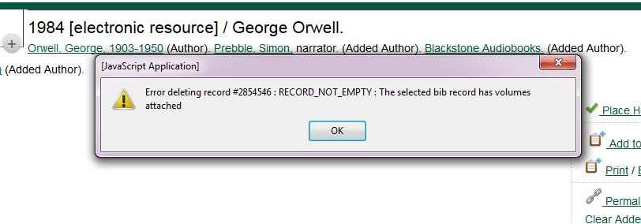
856 Holdings
Notes:
$9 fields are viewed as holdings in Evergreen (just like a barcoded item) and must be deleted before a record can be deleted

Slide 20
Scoping searches
Because the global flag is set to false, searches scoped to the consortium level will not find all resources a patron may have access to. It is important to scope searches to take advantage of all the mechanisms in Evergreen for patrons who may have cards for multiple NC Cardinal libraries:
OPAC scoped to home system
Patron’s preferred library when logged in
Scoped searches for any system where patron has a library card
Notes:
Patrons may have library cards for multiple systems in NC Cardinal. Using a consortium-wide search will not display correctly cataloged e-resources owned by a system other than the one in the OPAC URL (or staff workstation in the staff client). So, patrons cannot see all electronic resources they may be eligible to use (if they have cards for different systems), when only searching NC Cardinal as a whole and not those individual systems. When searching for e-resources, patrons (and staff) should conduct separate searches, selecting each system where the patron has a library card. Patrons will also see links for their preferred library when logged into their account in the OPAC.

Slide 21
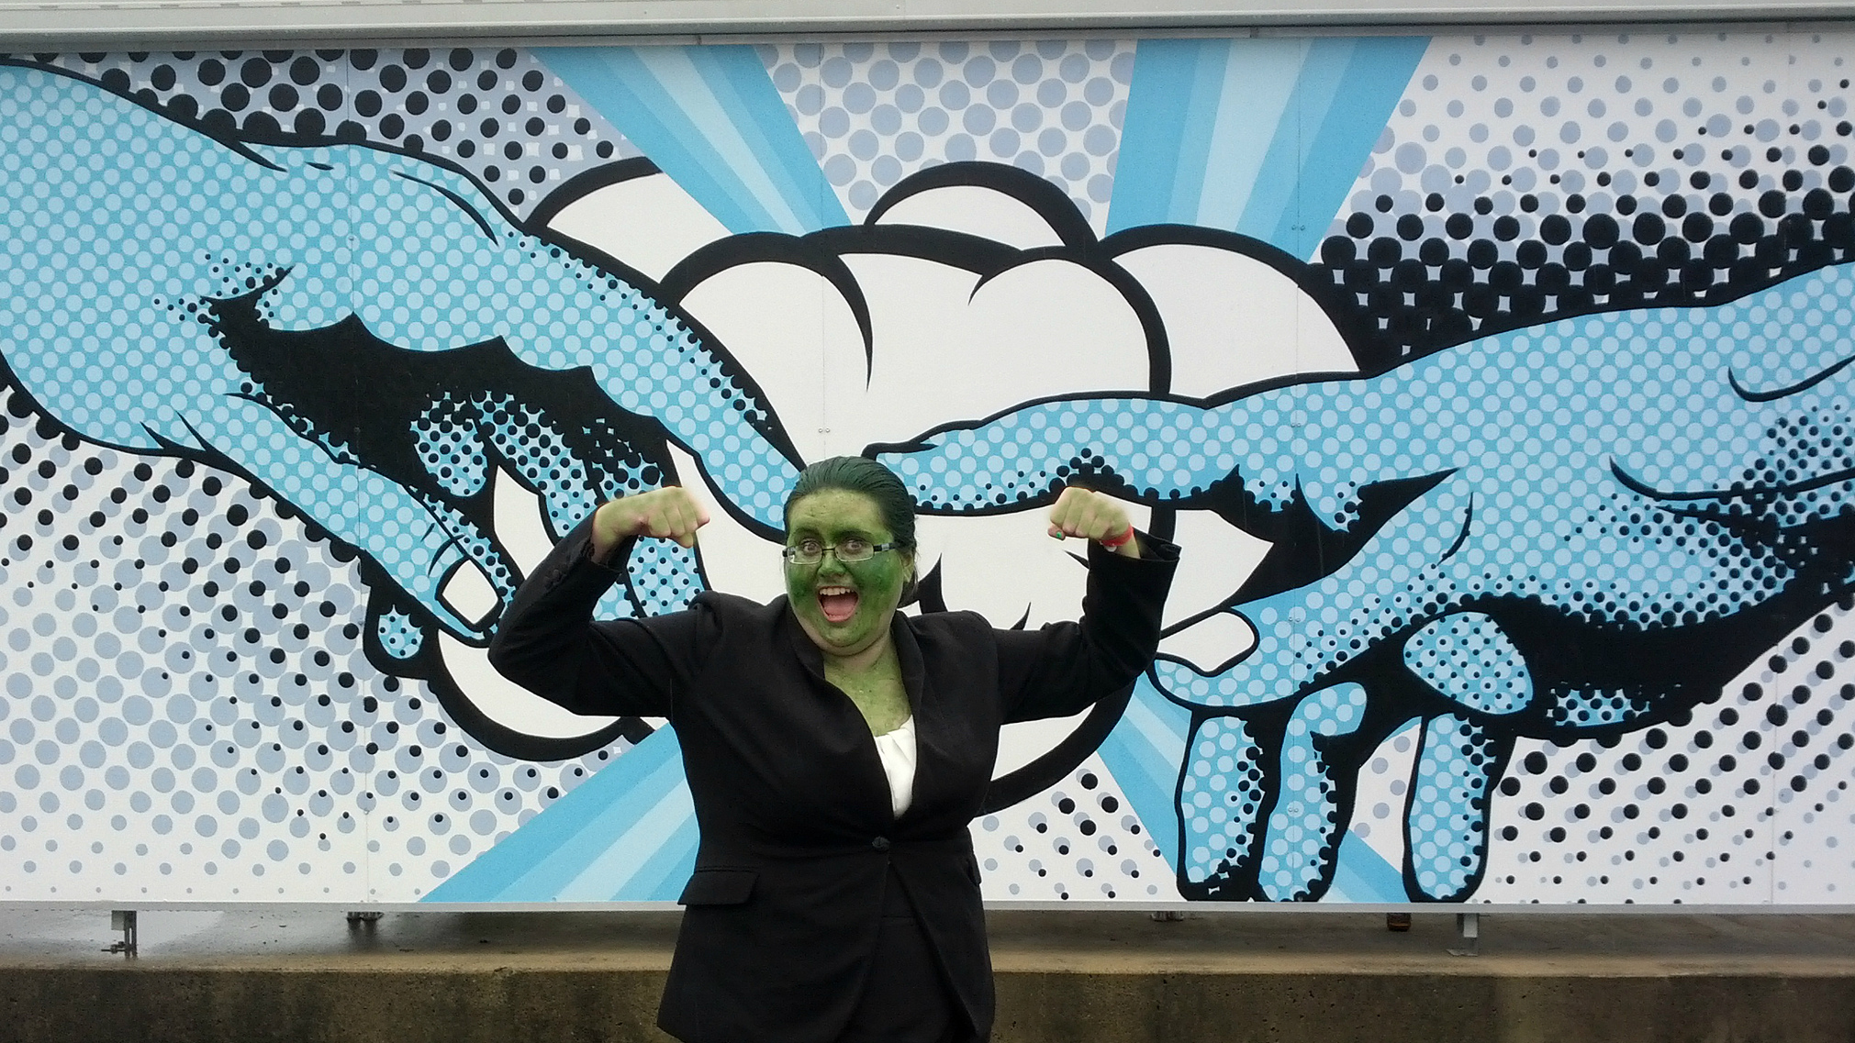
She-Hulk Librarian: A Strong Start to My Career by klfair (CC BY-NC-SA 2.0)
Notes:
Does anyone have questions or anything they want to add about their experience with Located URIs? What does transcendence contribute if you’re successfully using Located URIs?

Slide 22
Subfield x
Identify 856 by purchaser
?
Notes:
We have started a small pilot project where we are adding e-resources with a value or "code" in the $x. This code can be used to distinguish who is the purchaser of the resource. Not that this is an issue we have encountered, but this field could help identify who imported the 856 where there are multiple purchasers and who should delete expired resources.

Slide 23
Reporting on a subfield - Display
Display Name | Data Type | Field Transform | Source
TCN Value | text | Raw Data | Bibliographic Record
Title | text | Raw Data | Bibliographic Record::Simple Record Extract
Author | text | Raw Data | Bibliographic Record::Simple Record Extract
ISBN | text | Raw Data | Bibliographic Record::Simple Record Extract
Subfield Value | text | Raw Data | Bibliographic Record::Flattened MARC Fields
Notes:
$x can be used for reporting purposes. With all of the different units adding 856 fields, staff have expressed a difficult time in cleaning up the catalog and in adding new libraries org units $9 to the existing 856. Currently the "cleanup crews" are having to search manually by ISBN in the catalog to identify their e-resources. With the $x this field can be reported on displaying current titles using that value/code. Using Excel they can extrapolate expired titles and create a CSV

Slide 24
Reporting on a subfield - Filters
Filter Field | Field Transform | Operator | Value | Source
Is Deleted? | Raw Data | Equals | False | Bibliographic Record
Tag | Raw Data | Contains Matching substring (ignore case) |  | Bibliographic Record::Flattened MARC Fields
Subfield | Raw Data | Contains Matching substring (ignore case) |  | Bibliographic Record::Flattened MARC Fields
Normalized Value | Raw Data | Contains Matching substring (ignore case) |  | Bibliographic Record::Flattened MARC Fields
Notes:
These are the filters we use to only display bibs that are utilizing the $x and the corresponding value.

Slide 25
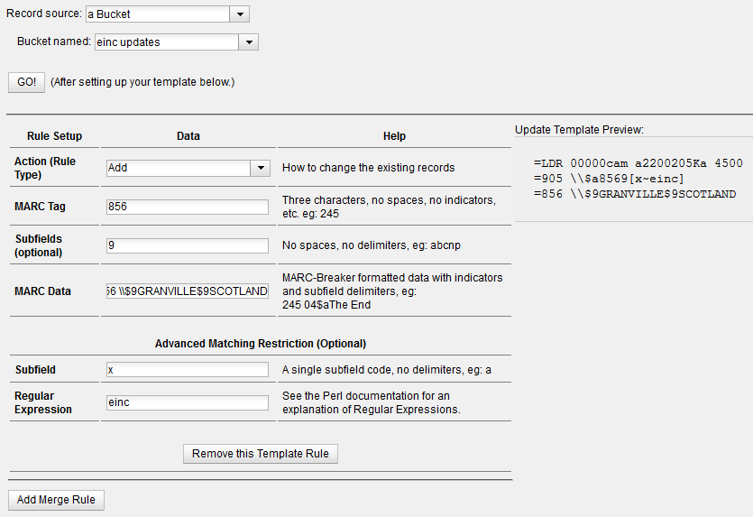
MARC Batch Edit - Add
Notes:
Using the MARC Batch Edit staff can add subfields to existing 856 without having to duplicate the complete 856 by using the Advanced Matching Restriction. The Record Source at the top of the screen is not the same as the Bibliographic Record Source. Your record source options in MARC Batch Edit are Record Bucket, CSV file, or Record ID.

Slide 26
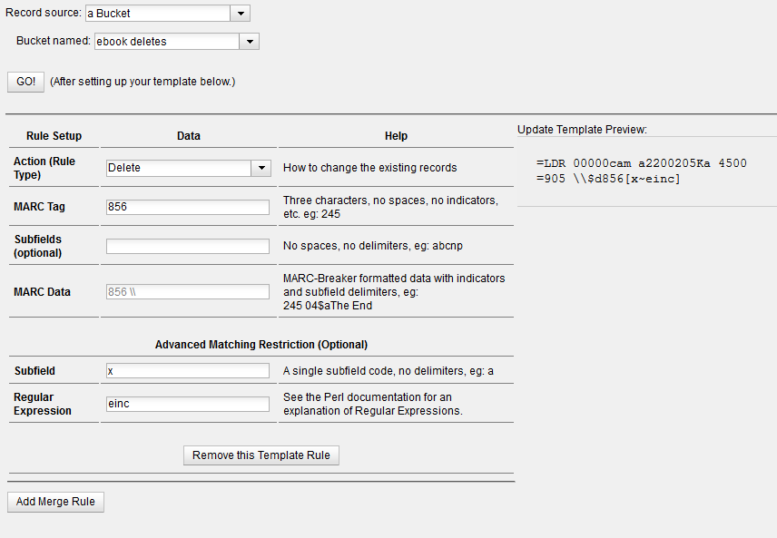
MARC Batch Edit - Delete
Notes:
856 fields can also be deleted by using the $x in the Advanced Matching Restriction. This is especially useful when there are multiple purchased resources on the same bib record. 856 tags can be deleted in bulk rather than one by one.

Slide 27
Changes in 2.11
Notes:
We are not on 2.11 currently but are excited to see that the bib source is now displayed in the 901$s. We did a quick test on Webby to see if $s was manually changed in the MARC if the source would change when saved. It does not. As a development plug, and speaking from personal experience of having to change hundreds of incorrect bib sources, we would like to see a method to change the bib source in batch.

Slide 28
?
?
?
?
?
?
Questions?
?
?
?
?
?

Slide 29
The Secret Life of Electronic Resources: A Tale of Transcendence
Catherine Prince: catherine.prince@ncdcr.gov
April Durrence: april.durrence@ncdcr.gov
NC Cardinal is a program of the State Library of North Carolina, supported by grant funds from the Institute of Museum and Library Services under the provisions of the Federal Library Services and Technology Act.

