Slide 1
PINES
Web Client
Training
Evergreen 3.0

Slide 2
October 9 - December 15, 2017: Testing
Testing checklists should be updated as testing is done so that the PINES team can begin reviewing potential problems and bugs as soon as possible prior to the upgrade.
Problems can be recorded on the checklists or in the Help Desk (use the topic “PINES / Web Client Issues”)

Slide 3
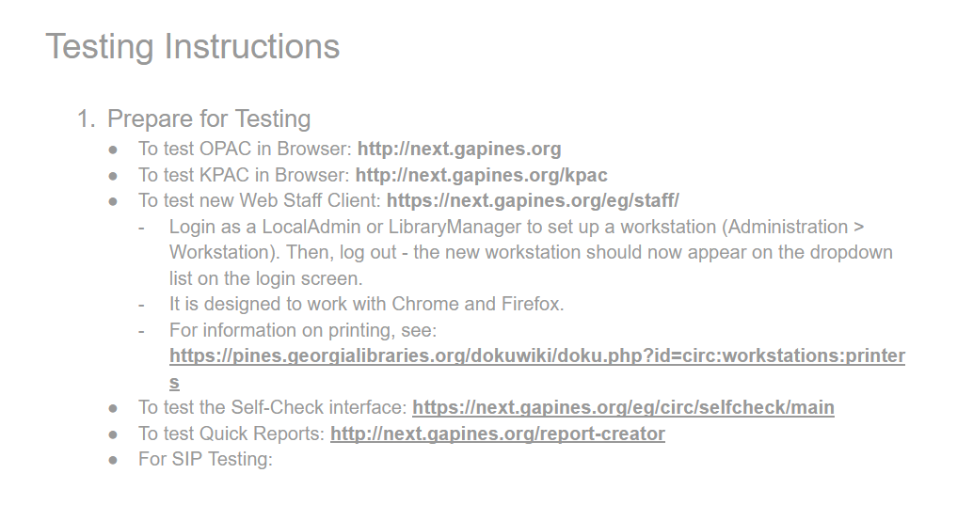

Slide 4
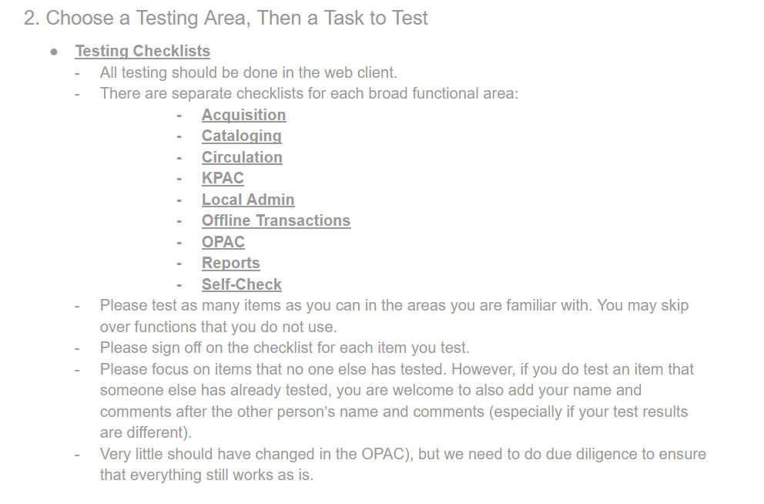

Slide 5
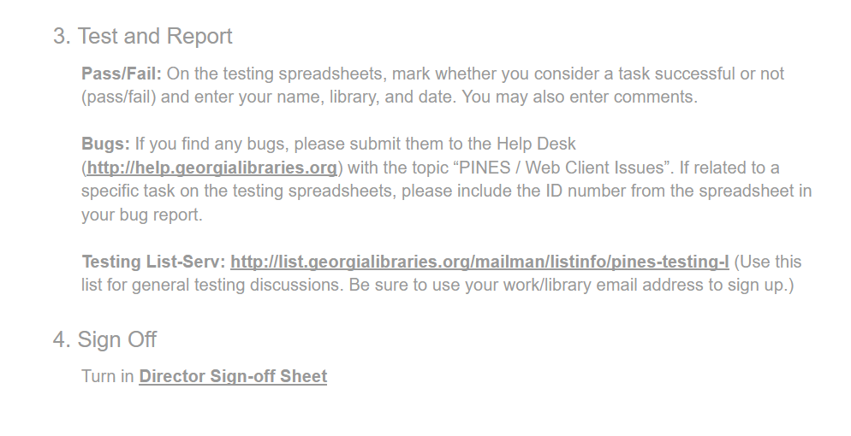

Slide 6
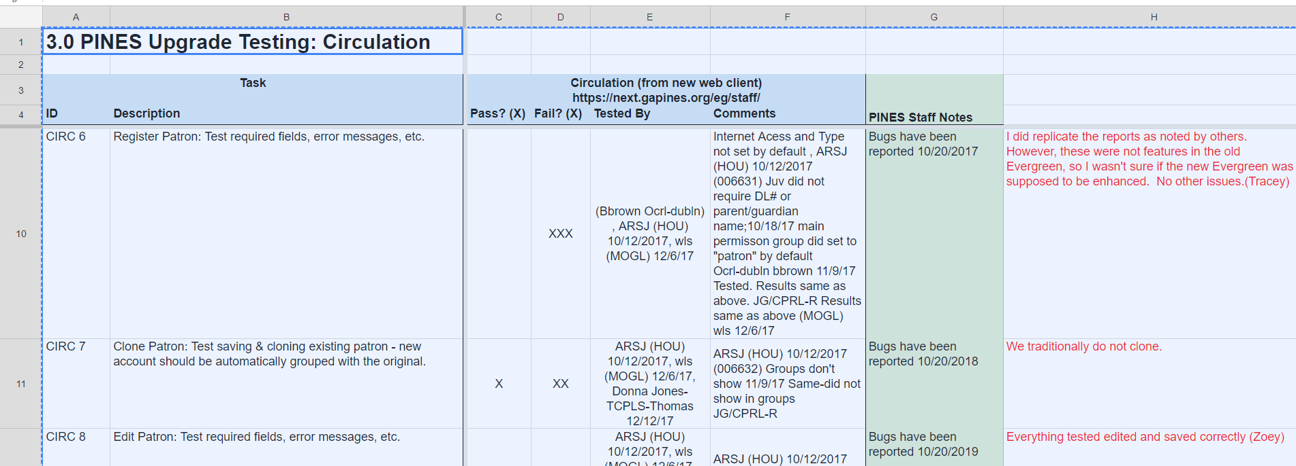

Slide 7
 | July - December 2017
 | Date | Location | Class | Instructor(s) | Hours
1 | 9/25/2017 | NEG | Web Client Training | Terran / Dawn | 5
2 | 9/26/2017 | ARL | Web Client Training | Terran / Dawn | 5
3 | 9/27/2017 | WGRL | Web Client Training | Terran / Dawn | 5
4 | 10/10/2017 | HCLS | Web Client Training | Terran / Dawn | 5
5 | 10/11/2017 | URRLS | Web Client Training | Terran / Dawn | 5
6 | 10/17/2017 | BTRL | Web Client Training | Terran / Dawn | 5
7 | 10/23/2017 | WebEx | Web Client Training | Terran / Dawn | 5
8 | 10/24/2017 | FRRLS | Web Client Training | Terran / Dawn | 5
9 | 10/25/2017 | LEE | Web Client Training | Terran / Dawn | 5
10 | 10/26/2017 | MGRL | Web Client Training | Terran / Dawn | 5
11 | 10/30/2017 | CHRL | Web Client Training | Terran / Dawn | 5
12 | 11/8/2017 | Athens | Staff Development Day | Dawn | 1
13 | 11/9/2017 | LOPL | Live Oak Training | Dawn | 6
14 | 11/14/2017 | CPRL | Web Client Training | Terran / Dawn | 5
15 | 11/15/2017 | SGRL | Web Client Training | Terran / Dawn | 5
16 | 11/16/2017 | MOGL | Web Client Training | Terran / Dawn | 5
17 | 11/20/2017 | WebEx | Web Client Cataloging | Elaine / Terran | 2
18 | 11/27/2017 | WebEx | Web Client Cataloging | Elaine / Terran | 2
19 | 11/28/2017 | STRL | Web Client Training | Terran / Dawn | 5
20 | 11/30/2017 | LOPL | Live Oak Training (Circ) | Terran / Dawn | 6
21 | 12/6/2017 | SWGRL | Web Client Training | Terran / Dawn | 5
22 | 12/14/2017 | PIED | Web Client Training | Dawn | 2
23 | 1/5/2018 | Jefferson County | Staff Day - Web Client | Dawn Dale | 3
24 | 11-Jan | GPLS | Upgrade Q&A (WebEx) | PINES Team | 2
25 | 1/12/2018 | Houston County | Staff Day - Web Client | Dawn Dale | 1
 | Web Client Go Live
26 | 13-Feb | GPLS | Live Oak Go-Live Q&A (WebEx) | PINES Team | 2
27 | 3/1/2018 | LOPL | Staff Day Q&A | Terran / Dawn | 2
28 | 4/20/2018 | Clayton | Web Client Training | Dawn Dale | 1
29 | 4/20/2018 | Henry County | Web Client Training | Dawn Dale | 1

Slide 8
How To Log In To Evergreen

